Slide 1
LECTURE #4b
INTRODUCTION
  To understand written mathematics, one must understand what makes up a correct mathematical argument, that is, a proof. This requires an understanding of the techniques used to build proofs. The methods we will study for building proofs are also used throughout computer science, such as the rules computers used to reason, the techniques used to verify that programs are correct, etc.
  Many theorems in mathematics are implications, p →q. The techniques of proving implications give rise to different methods of proofs.
METHODS OF PROOF
DIRECT PROOF
p→q
INDIRECT PROOF
PROOF BY
CONTRAPOSITION
p →q≡ ~q→~p
PROOF BY
CONTRADICTION
p →q ≡(p∧~q) →c

Slide 2
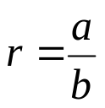
DIRECT PROOF
  The implication p →q can be proved by showing that if p is true, then q must also be true. This shows that the combination p true and q false never occurs. A proof of this kind is called a direct proof (or if there does not exist a condition of p true and q false).
p | q | p →q
T | T | T
T | F | F
F | T | T
F | F | T
SOME BASICS
  1. An integer n is even if, and only if, n = 2k for some integer k like 6=2(3).
  2. An integer n is odd if, and only if, n = 2k + 1 for some integer k e,g.(7=2(3)+1.
  3. An integer n is prime if, and only if, n > 1 and for all positive integers r and s, if n = r·s, then r = 1 or s = 1.
  4. An integer n > 1 is composite if, and only if, n = r·s for some positive integers r and s with r ≠ 1 and s ≠ 1(e.g 7 is a prime number and 8 is a composite number as 8=(4)(2).
  5.A real number r is rational if, and only if, for some integers a and b with b≠0.
  6.If n and d are integers and d ≠0, then d divides n, written d|n if, and only if, n = d.k for some integers k.
  7.An integer n is called a perfect square if, and only if, n = k² for some integer k(e.g 16=4²⁾.

Slide 3
EXERCISE
Prove that the sum of two odd integers is even.
  SOLUTION
  Let m and n be two odd integers. Then by definition of odd numbers
  m = 2k + 1 for some k ∈Z
  n = 2l + 1 for some l ∈ Z
  Now m + n = (2k + 1) + (2l + 1)
  = 2k + 2l + 2
  = 2 (k + l + 1)
  = 2r where r = (k + l + 1) ∈Z
  Hence m + n is even.
EXERCISE
  Prove that if n is any even integer, then
  (-1) ^{n} = 1
  SOLUTION
  Suppose n is an even integer. Then n = 2k for some integer k.
  Now
  (-1)^{n}= (-1)^{2k}
  = [(-1)²]^{k}
  = (1)^{k}
  = 1 (proved)

Slide 4
EXERCISE
EXERCISE
  Prove that the product of an even integer and an odd integer is even.
  SOLUTION
  Suppose m is an even integer and n is an odd integer. Then
  m = 2k for some integer k
  and n = 2l + 1 for some integer l
  Now
  m·n = 2k · (2l + 1)
  = 2·k (2l + 1)
  = 2·r where r = k(2l + 1) is an integer
  Hence m·n is even. (Proved)
  Prove that the square of an even integer is even.
  SOLUTION
  Suppose n is an even integer. Then
  n = 2k
  Now
  square of n = n² = (2·k)²
  = 4k²
  = 2·(2k²)
  = 2·p where p = 2k² ∈Z
  Hence, n² is even. (proved)

Slide 5
EXERCISE
EXERCISE
  Prove that if n is an odd integer, then n³ + n is even.
  SOLUTION
  Let n be an odd integer, then n = 2k + 1for some k ∈Z
  Now n³ + n = n (n² + 1)
  = (2k + 1) ((2k+1)² + 1)
  = (2k + 1) (4k² + 4k + 1 + 1)
  = (2k + 1) (4k² + 4k + 2)
  = (2k + 1) 2. (2k² + 2k + 1)
  = 2·(2k + 1) (2k² + 2k + 1) k ∈Z
  = an even integer
  Prove that, if the sum of any two integers is even, then so is their difference.
  SOLUTION
  Suppose m and n are integers so that m + n is even. Then by definition of even numbers
  m + n = 2k for some integer k
  ⇒ m = 2k - n ……………….(1)
  Now m - n= (2k - n) - n using (1)
  = 2k - 2n
  = 2 (k - n) = 2r where r = k - n is an integer
  Hence m - n is even.

Slide 6
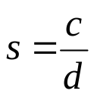
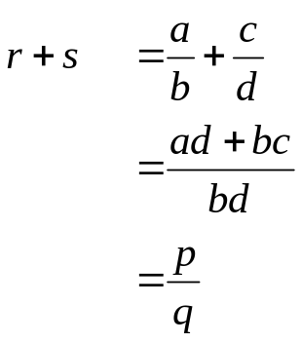
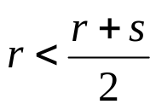
EXERCISE
  Prove that the sum of any two rational numbers is rational.
  SOLUTION
  Suppose r and s are rational numbers.
  Then by definition of rational
and
for some integers a, b, c, d with b≠0 and d≠0
Now
where p = ad + bc ∈Z and q =bd ∈Z
and q ≠0
  Hence r + s is rational.
EXERCISE
  Given any two distinct rational numbers r and s with r < s. Prove that there is a rational number x such that r < x < s.
  PROOF
  Given two distinct rational numbers r and s such that
  r < s ………………….(1)
  Adding r to both sides of (1), we get
  r + r < r + s
  2r < r + s
  ⇒
………………….(2)

Slide 7
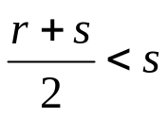
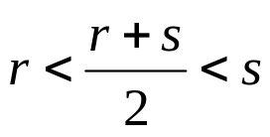

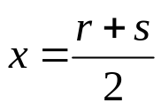
EXERCISE
  Next adding s to both sides of (1), we get
  r + s < s + s
  ⇒ r + s < 2s
  ⇒ ………………………(3)
  Combining (2) and (3), we may write
……………………..(4)
  Since the sum of two rationals is rational, therefore r + s is rational. Also the quotient of a rational by a non-zero rational, is rational, therefore is rational and by (4) lies between r & s.
  Hence, we have found a rational number
  such that r < x < s. (proved)
  Prove that for all integers a, b and c, if a|b and b|c then a|c.
  PROOF
  Suppose a|b and b|c where a, b, c ∈Z. Then by definition of divisibility
  b=a·r and c=b·s for some integers r and s.
  Now c = b·s
  = (a·r)·s (substituting value of b)
  = a·(r·s) (associative law)
  = a·k where k = r·s ∈ Z
  ⇒ a|c by definition of divisibility

Slide 8
EXERCISE
  Prove that for all integers a, b and c if a|b and a|c then a|(b+c)
  PROOF
  Suppose a|b and a|c where a, b, c ∈Z
  By definition of divides
  b = a·r and c = a·s for some r, s ∈Z
  Now
  b + c = a·r + a·s (substituting values)
  = a·(r+s) (by distributive law)
  = a·k where k = (r + s) ∈Z
  Hence a|(b + c) by definition of divides.
EXERCISE
  Prove that the sum of any three consecutive integers is divisible by 3.
  PROOF
  Let n, n + 1 and n + 2 be three consecutive integers.
  Now
  n + (n + 1) + (n + 2) = 3n + 3
  = 3(n + 1)
  = 3·k where k=(n+1)∈Z
  Hence, the sum of three consecutive integers is divisible by 3.

Slide 9



EXERCISE
  Prove the statement:
  There is an integer n > 5 such that 2^{n} - 1 is prime
  PROOF
  Here we are asked to show a single integer for which 2^{n}-1is prime. First of all we will check the integers from 1 and check whether the answer is prime or not by putting these values in 2^{n}-1.when we got the answer is prime then we will stop our process of checking the integers and we note that,
  Let n = 7, then
  2^{n} - 1 = 2⁷ - 1 = 128 - 1 = 127
  and 127 is prime.
EXERCISE
  Prove the statement:
  There are real numbers a and b such that
  PROOF
  Let
  Squaring, a + b = a + b + 2
  ⇒ 0 = 2 canceling a+b
  ⇒ 0 =
  ⇒ 0 = ab squaring
  ⇒ Either a = 0 or b = 0
  It means that if we want to find out the integers which satisfy the given condition then one of them must be zero.

Slide 10
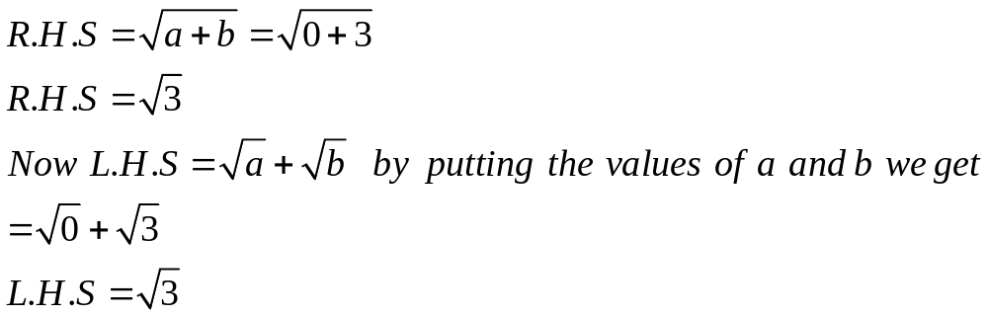
  Hence if we let a = 0 and b = 3 then
  From above it quite clear that the given condition is satisfied if we take a=0 and b=3.
PROOF BY COUNTER EXAMPLE
  Disprove the statement by giving a counter example.
  For all real numbers a and b, if a < b then a² < b².
  SOLUTION
  Suppose a = -5 and b = -2
  then clearly - 5 < - 2
  But a² = (-5)² = 25 and b² = (-2)² = 4
  But 25  4
  This disproves the given statement.
EXERCISE
  Prove or give counter example to disprove the statement.
  For all integers n, n² - n + 11 is a prime number.
  SOLUTION
  The statement is not true
  For n = 11we have , n² - n + 11 = (11)² - 11 + 11
  = (11)²
  = (11) (11)
  which is obviously not a prime number.

Slide 11

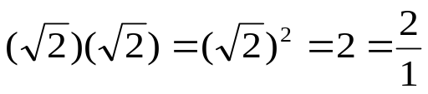
EXERCISE
  Prove or disprove that the product of any two irrational numbers is an irrational number.
  SOLUTION
  We know that is an irrational number. Now
  which is a rational number. Hence the statement is disproved.
EXERCISE
  Find a counter example to the proposition:
  For every prime number n, n + 2 is prime.
  SOLUTION
  Let the prime number n be 7 then
  n + 2 = 7 + 2 = 9
  which is not prime.

